Slide 1
Chapter 7: Laptops and Other Mobile Devices
Instructor Materials
IT Essentials v7.0
Notes:
Cisco Networking Academy Program
IT Essentials v7.0
Chapter 7: Laptops and Other Mobile Devices

Slide 2
Instructor Materials – Chapter 7 Planning Guide
This PowerPoint deck is divided in two parts:
Instructor Planning Guide
Information to help you become familiar with the chapter
Teaching aids
Instructor Class Presentation
Optional slides that you can use in the classroom
Begins on slide #15
Note: Remove the Planning Guide from this presentation before sharing with anyone.
Notes:
2

Slide 3
Chapter 7: Laptops and Other Mobile Devices
IT Essentials 7.0 Planning Guide
Notes:
Cisco Networking Academy Program
IT Essentials v7.0
Chapter 7: Laptops and Other Mobile Devices

Slide 4
Check Your Understanding and What Do You Already Know?
Check Your Understanding activities used to be called Interactive Activities. They simply have a new name. They are designed to let students quickly determine if they understand the content and can proceed, or if they need to review.
Check Your Understanding activities do not affect student grades.
Activities listed as What Do You Already Know? are a type of activity in which we ask the student to simply take a guess! It is not meant to evaluate their knowledge. It is only meant to give them a head start in thinking about different topics before they are presented in the course. Students receive addition content in the form of feedback for any answers they select.
What Do You Already Know? activities do not directly affect student grades; however, the feedback may contain content which appears later in quizzes and exams, so it is important that students complete the What Do You Already Know? activities.
Notes:
4

Slide 5
Chapter 7: Activities
What activities are associated with this chapter?
Page # | Activity Type | Activity Name | Optional?
7.1.1.1 | What Do You Already Know? | Mobile Devices | Recommended
7.1.1.9 | Check Your Understanding | Laptops and Other Mobile Devices | Recommended
7.1.1.10 | Lab | Mobile Device Information | Recommended
7.1.2.1 | Video Explanation | External Features Unique to Laptops | Recommended
7.1.2.2 | Video Explanation | Common Input devices and LEDs in Laptops | Recommended
7.1.2.5 | Check Your Understanding | External Laptop Components | Recommended
7.1.2.7 | Video Explanation | Docking Station Versus Port Replicator | Recommended
7.1.2.8 | Lab | Research Docking Stations and Port Replicators | Recommended
7.1.3.4 | Check Your Understanding | Laptop Display Components | Recommended
7.2.1.3 | Check Your Understanding | Match ACPI Standards | Recommended
Notes:
5

Slide 6
Chapter 7: Activities (Cont.)
What activities are associated with this chapter?
Page # | Activity Type | Activity Name | Optional?
7.2.1.4 | Video Demonstration | Managing Laptop Power Options | Recommended
7.2.2.3 | Video Demonstration | Bluetooth Configuration | Recommended
7.2.2.6 | Video Demonstration | Wi-Fi Configuration | Recommended
7.2.2.7 | Check Your Understanding | Wireless Configuration | Recommended
7.3.1.5 | Video Demonstration | Install SODIMM | Recommended
7.3.1.6 | Check Your Understanding | Expansion Modules | Recommended
7.3.2.2 | Video Demonstration | Keyboard Replacement | Recommended
7.3.2.3 | Video Demonstration | Screen Replacement | Recommended
7.3.2.4 | Lab | Research Laptop Screens | Recommended
7.3.2.6 | Video Demonstration | DC Jack Replacement | Recommended
7.3.2.7 | Lab | Research Laptop Batteries | Recommended
Notes:
6

Slide 7
Chapter 7: Activities (Cont.)
What activities are associated with this chapter?
Page # | Activity Type | Activity Name | Optional?
7.3.2.9 | Video Demonstration | Video – Internal Storage and Optical Drive Replacement | Recommended
7.3.2.10 | Lab | Research Laptop Drives | Recommended
7.3.2.11 | Video Demonstration | Wireless Card Replacement | Recommended
7.3.2.12 | Video Demonstration | Speakers Replacement | Recommended
7.3.2.13 | Video Demonstration | CPU Replacement | Recommended
7.3.2.14 | Video Demonstration | Motherboard Replacement | Recommended
7.3.2.15 | Video Demonstration | Plastic Frames | Recommended
7.3.2.16 | Check Your Understanding | Replacing Laptop Components | Recommended
7.4.1.4 | Check Your Understanding | Identify Connection Types | Recommended
7.5.1.2 | Lab | Mobile Wi-Fi | Recommended
Notes:
7

Slide 8
Chapter 7: Activities (Cont.)
What activities are associated with this chapter?
Page # | Activity Type | Activity Name | Optional?
7.5.1.6 | Check Your Understanding | Wireless Technology | Recommended
7.5.3.2 | Check Your Understanding | Matching Email Protocols | Recommended
7.6.1.1 | What Do You Already Know? | Preventive Maintenance | Optional
7.7.2.4 | Lab | Research Laptop Specifications | Recommended
7.7.2.5 | Lab | Gather Information from the Customer | Recommended
7.7.2.6 | Lab | Investigate Support Websites | Recommended
Notes:
8

Slide 9
Chapter 7: Assessment
Students should complete Chapter 7, “Assessment” after completing Chapter 7.
Quizzes, labs, Packet Tracers and other activities can be used to informally assess student progress.
Notes:
9

Slide 10
Chapter 7: Best Practices
Prior to teaching Chapter 7, the instructor should:
Complete Chapter 7, “Assessment.”
The objectives of this chapter are:
Describe the features of mobile devices.
Describe the features of laptop components.
Compare the types of laptop displays.
Explain how to configure power settings on laptops.
Explain how to configure wireless communication on laptops.
Explain how to remove and install laptop memory and adapter modules.
Explain how to remove and install laptop hardware.
Describe common mobile device hardware.
Describe the hardware components of specialty mobile devices.
Explain how to configure wireless and cellular data settings.
Explain how to pair Bluetooth devices.
Explain how to configure email settings.
Explain how to synchronize data.
Explain how to schedule and perform laptop and mobile device maintenance.
Explain the six steps of troubleshooting Laptops and other Mobile Devices.
Describe common problems and solutions related to Laptops and other Mobile Devices.
Notes:
10

Slide 11
Chapter 7: Best Practices (Cont.)
Ensure this chapter becomes as hands-on as possible.
One idea is to get used older used laptops and disassemble them even if they don’t work any more.
Ask the students to bring in their own smartphones or mobile devices and tell of some of their configuration challenges.
If you only have one laptop, you still could have the disassembly PDF displayed in the classroom. One student at a time comes up and does the step being demonstrated like removing the RAM. The process is explained and most laptop disassembly procedures include graphics. Each student gets to do one step of the process while the instructor is talking about best practices.
Demonstrate a laptop computer with focus on physical components, features, adapters, etc.
Demonstrate an Android and iOS smartphone with focus on physical components, features, connectors, etc.
Explain and demonstrate the use of the laptop display. Videos of display replacement for different models are effective in this area.
Notes:
11

Slide 12
Chapter 7: Best Practices (Cont.)
Demonstrate the configuration of laptop power settings and wireless settings.
Having a student actually doing the process of what you are explaining and rotating through students gives them hands-on practice even when parts are limited.
Be sure to demonstrate or talk about how some laptops might have a button to disable wireless and/or function keys. Function keys to emphasize and demonstrate are wireless, Bluetooth, and external display. It would also be good to show a couple of different models. If real devices are not available, have URLs at the ready to show how it would be done on a couple of different models.
Demonstrate the removal and installation of laptop components.
Demonstrate the configuration of network connectivity and email on mobile devices.
Demonstrate how to pair Bluetooth devices.
Stress the importance of scheduled/preventive maintenance for both laptops and other mobile devices.
Notes:
12

Slide 13
Chapter 7: Additional Help
For additional help with teaching strategies, including lesson plans, analogies for difficult concepts, and discussion topics, visit the ITE Community at: https://www.netacad.com/group/communities/community-home
Best practices from around the world for teaching IT Essentials. https://www.netacad.com/group/communities/it-essentials
If you have lesson plans or resources that you would like to share, upload them to the ITE Community in order to help other instructors.
Students can enroll in Introduction to Packet Tracer (self-paced).
Notes:
13

Slide 14
Chapter 7: Laptops and Other Mobile Devices
IT Essentials v7.0
Notes:
Cisco Networking Academy Program
IT Essentials v7.0
Chapter 7: Laptops and Other Mobile Devices

Slide 15
Chapter 7 - Sections & Objectives
7.1 Characteristics of laptops and other mobile devices
Describe the features of mobile devices.
Describe the features of laptop components.
Compare the types of laptop displays.
7.2 Laptop Configuration
Explain how to configure power settings on laptops.
Explain how to configure wireless communication on laptops.
7.3 Laptop Hardware and Component Installation and Configuration
Explain how to remove and install laptop memory and adapter modules.
Explain how to remove and install laptop hardware.
7.4 Other Mobile Device Hardware Overview
Describe common mobile device hardware.
Describe the hardware components of specialty mobile devices.
Notes:
15
Cisco Networking Academy Program
IT Essentials v7.0
Chapter 7: Laptops and Other Mobile Devices

Slide 16
Chapter 7 - Sections & Objectives (Cont.)
7.5 Network Connectivity and Email
Explain how to configure wireless and cellular data settings.
Explain how to pair Bluetooth devices.
Explain how to configure email settings.
Explain how to synchronize data.
7.6 Preventive Maintenance for Laptops and other Mobile Devices
Explain how to schedule and perform laptop and mobile device maintenance.
7.7 Basic Troubleshooting Process for Laptops and other Mobile Devices
Explain the six steps of troubleshooting Laptops and other Mobile Devices.
Describe common problems and solutions related to Laptops and other Mobile Devices.
Notes:
16
Cisco Networking Academy Program
IT Essentials v7.0
Chapter 7: Laptops and Other Mobile Devices

Slide 17
7.1 Characteristics of Laptops and Other Mobile Devices
Notes:
7 – Laptops and Other Mobile Devices
7.1 – Characteristics of laptops and other mobile devices

Slide 18

Mobile Device Overview Mobility
Mobility in information technology means the ability to access information electronically from different locations outside of the home or office.
Mobile connectivity is limited only by the availability of cellular or data networks.
Mobile devices:
have self-contained power (rechargeable batteries)
are generally small and lightweight
do not rely on other connected peripheral devices to operate.
Notes:
7.1 – Characteristics of laptops and other mobile devices
7.1.1 – Mobile Device Overview
7.1.1.1 – What Do You Already Know? – Mobile Devices
7.1.1.2 – Mobility

Slide 19
Mobile Device Overview Laptops
Laptops are portable computers that usually run full versions of operating systems such as Microsoft Windows, iOS or Linux.
Laptops can have the same computing power and memory resources as desktop computers.
Laptops integrate a screen, keyboard, and a pointing device, such as a touchpad, in one portable device.
Laptops can be run from an internal battery or from an electrical outlet.
They offer connectivity options such as wired or wireless Ethernet networking and Bluetooth.
Laptops offer device connection options such as USB and HDMI, but may lack the expansion capability of desktops.
In order to make laptops more portable, some peripheral connection options may require additional hardware, such as a dock or port replicator.
Notes:
7.1 – Characteristics of laptops and other mobile devices
7.1.1 – Mobile Device Overview
7.1.1.3 – Laptops

Slide 20

Mobile Device Overview Smartphone Characteristics
Smartphones run special operating systems that are designed for mobile devices.
Smartphones may have limited OS upgradability and can require the purchase of a new model to take advantage of the latest OS features and apps.
Software for smartphones is usually limited to apps that can be downloaded from stores such as Google Play or the Apple App Store.
Smartphones use cellular connectivity options for voice, text, and data services.
Other data connections include Bluetooth and Wi-Fi.
Notes:
7.1 – Characteristics of laptops and other mobile devices
7.1.1 – Mobile Device Overview
7.1.1.4 – Smartphone Characteristics

Slide 21
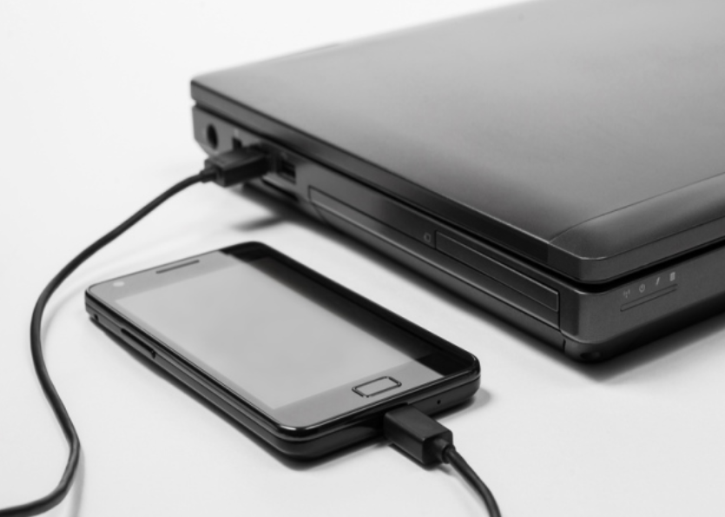
Mobile Device Overview Smartphone Features
Most smartphones include global positioning system (GPS) functionality.
A GPS receiver in the phone uses satellites to determine the geographic location of the device.
Some apps allow a smartphone to act as a navigational GPS that provides guidance for driving, biking, or walking.
Devices without a GPS service can still determine the location, in a less precise way, by using info coming from nearby mobile service antennas or nearby Wi-Fi access points.
Another feature of some smartphones is the ability to "tether", or share, the cellular data connection with other devices.
Notes:
7.1 – Characteristics of laptops and other mobile devices
7.1.1 – Mobile Device Overview
7.1.1.5 – Smartphone Features

Slide 22

Mobile Device Overview Tablets and E-Readers
Tablets are similar to smartphones in that they use special mobile operating systems like Android or iOS.
Tablets usually offer Wi-Fi and Bluetooth connectivity and most have USB and audio ports.
Most of the apps that work on phones are also available for tablets.
Unlike smartphones, tablets normally have larger touch-screen displays.
Most tablets do not have the ability to access cellular networks and they usually do not include GPS receivers.
Notes:
7.1 – Characteristics of laptops and other mobile devices
7.1.1 – Mobile Device Overview
7.1.1.6 – Tablets and E-Readers

Slide 23

Mobile Device Overview Tablets and E-Readers (Cont.)
E-readers, such as the Amazon Kindle, are special purpose devices with black and white displays that have been optimized for reading text.
Although they resemble tablets, they lack many of the features and functions that tablets provide.
Many have touch displays that make it easy to turn pages, change settings, and access eBooks online.
For connectivity, some offer free cellular data connections for downloading books from a specific store, but most rely on Wi-Fi.
E-reader battery life is usually longer than tablets.
Notes:
7.1 – Characteristics of laptops and other mobile devices
7.1.1 – Mobile Device Overview
7.1.1.6 – Tablets and E-Readers (Cont.)

Slide 24
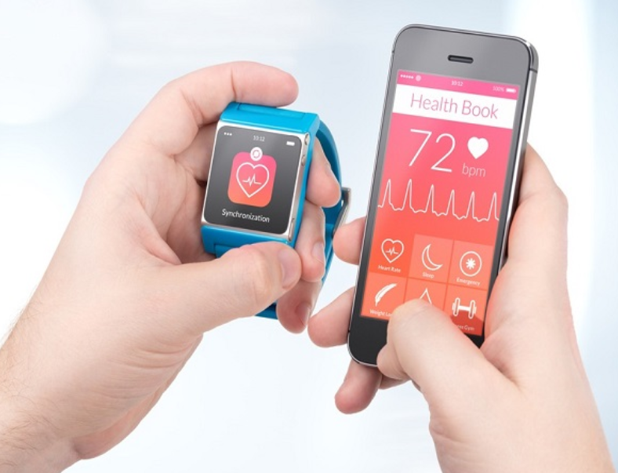
Mobile Device Overview Wearables: Smartwatches and Fitness Trackers
Wearables are smart devices that are meant to be worn on the body or attached to clothing.
Smartwatches are a type of wearable that includes a microprocessor, a special operating system, and apps.
Sensors in the smartwatch can gather data about various aspects of the body and use Bluetooth to report this information back to another device
Some smartwatches can connect directly to a cellular network, utilize GPS location services, provide convenient displays for notifications from apps, and store and play music and playlists.
Fitness trackers are similar to smartwatches but are limited to monitoring the body such as physical activity, sleep, and exercise.
Notes:
7.1 – Characteristics of laptops and other mobile devices
7.1.1 – Mobile Device Overview
7.1.1.7 – Wearables: Smartwatches and Fitness Trackers

Slide 25
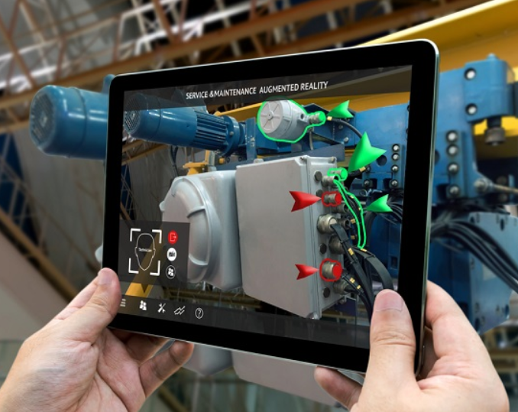
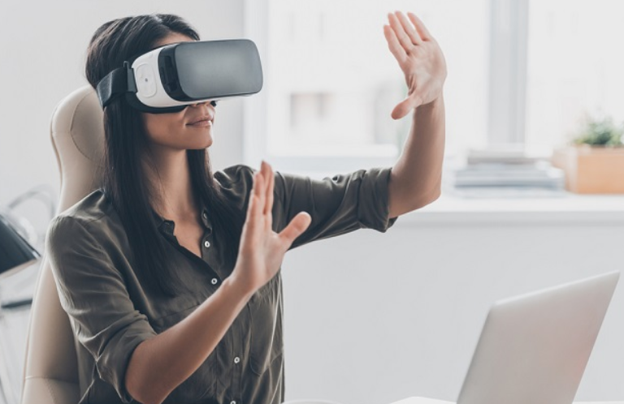
Mobile Device Overview Wearables: Augmented and Virtual Realities
In Augmented Reality (AR), computer graphics are integrated with what is seen in the real world.
The graphics overlays can range from cartoon characters in a game application to information for emergency management training for first responders.
In Virtual Reality (VR), a user wears a special headset which displays graphics from a separate computer.
The graphics are immersive 3D and create very realistic worlds.
The VR user's motions are detected by sensors which allow the user to interact with and move around in the virtual environment.
Notes:
7.1 – Characteristics of laptops and other mobile devices
7.1.1 – Mobile Device Overview
7.1.1.8 – Wearables: Augmented and Virtual Realities
7.1.1.9 – Check Your Understanding – Laptops and Other Mobile Devices

Slide 26
Mobile Device Overview Lab – Mobile Device Information
In this lab, you will use the internet, a technical journal, or a local store to gather information about an Android and an iOS device. You will document the specifications of each Android and iOS device onto this worksheet. Be prepared to discuss your decisions regarding the devices you select.
Notes:
7.1 – Characteristics of laptops and other mobile devices
7.1.1 – Mobile Device Overview
7.1.1.10 – Lab – Mobile Device Information

Slide 27
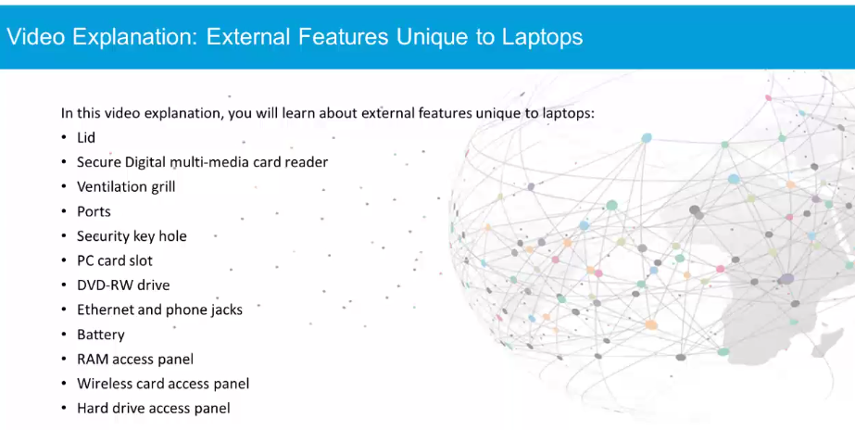
Laptop Components Video Explanation – External Features Unique to Laptops
Notes:
7.1 – Characteristics of laptops and other mobile devices
7.1.2 – Laptop Components
7.1.2.1 – Video Explanation – External Features Unique to Laptops

Slide 28
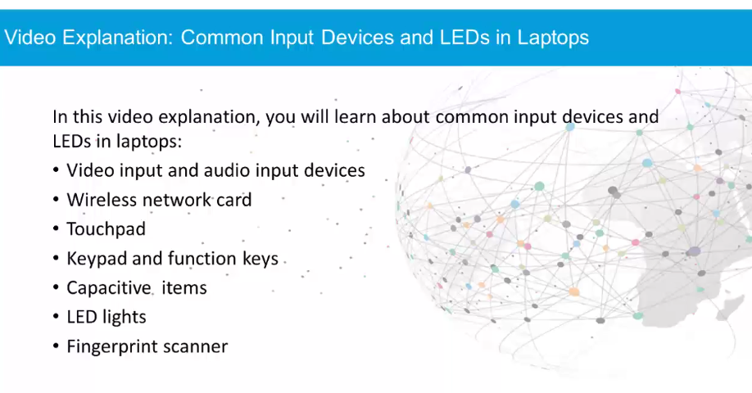
Laptop Components Video Explanation – Common Input Devices and LEDs in Laptops
Notes:
7.1 – Characteristics of laptops and other mobile devices
7.1.2 – Laptop Components
7.1.2.2 – Video Explanation – Common Input Devices and LEDs in Laptops

Slide 29
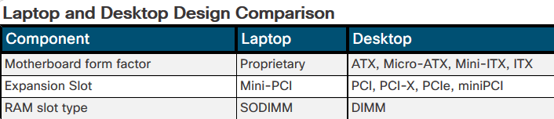
Laptop Components Motherboards
The compact nature of laptops requires a number of internal components to fit in a small amount of space.
The size restrictions result in a variety of form factors for a number of laptop components, such as the motherboard, RAM, CPU, and storage devices.
Some laptop components, such as the CPU, may be designed to use less power.
Desktop motherboards have standard form factors.
The standard size and shape allow motherboards from different manufacturers to fit into common desktop cases.
Laptop motherboards vary by manufacturer and are proprietary.
Notes:
7.1 – Characteristics of laptops and other mobile devices
7.1.2 – Laptop Components
7.1.2.3 – Motherboards

Slide 30
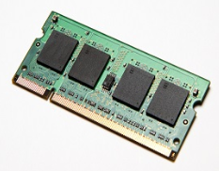
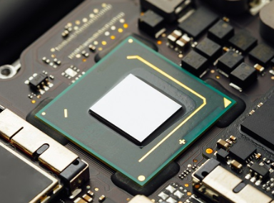
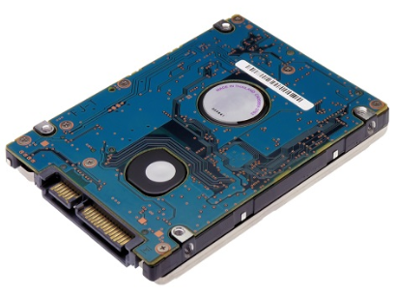
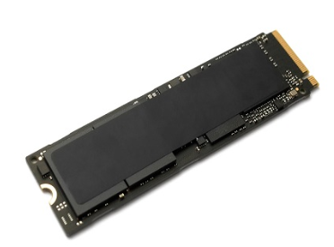
Laptop Components Internal Components
Laptop internal components are designed to fit into the confined spaces of the laptop form factor:
RAM – Laptops use Small Outline Dual In-line Memory Modules (SODIMM)
CPUs – Laptop processors are designed to use less power and create less heat than desktop CPUs
SATA drives- Laptop storage devices are typically 1.8in or 2.5in in width.
Solid-state drives – Laptops use SSD drives for high performance, small size, and low power consumption.
Notes:
7.1 – Characteristics of laptops and other mobile devices
7.1.2 – Laptop Components
7.1.2.4 – Internal Components
7.1.2.5 – Check Your Understanding – External Laptop Components

Slide 31
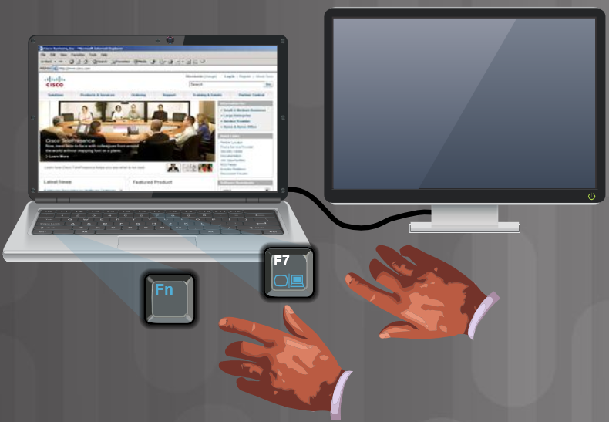
Laptop Components Special Function Keys
The purpose of the Function (Fn) key is to activate a second function on a dual-purpose key.
The feature that is accessed by pressing the Fn key in combination with another key is printed on the key in a smaller font or different color or with an icon.
Some examples of functions that can be accessed:
Dual displays
Volume settings
Media options such as fast forward or rewind
Keyboard backlight
Screen orientation
Screen brightness
WiFi, cellular, and Bluetooth on or off
Media options such as play or rewind
Touchpad on or off
GPS on or off
Airplane mode
Notes:
7.1 – Characteristics of laptops and other mobile devices
7.1.2 – Laptop Components
7.1.2.6 – Special Function Keys

Slide 32
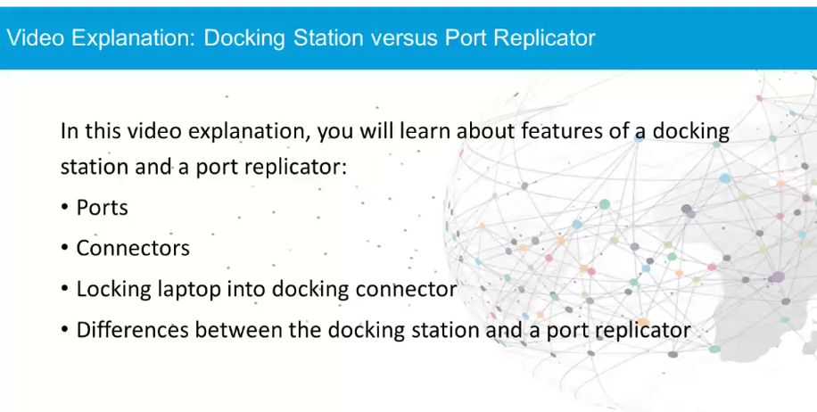
Laptop Components Video Explanation – Docking Station versus Port Replicator
Notes:
7.1 – Characteristics of laptops and other mobile devices
7.1.2 – Laptop Components
7.1.2.7 – Video Explanation – Docking Station Versus Port Replicator

Slide 33
Laptop Components Lab – Research Docking Stations and Port Replicators
A docking station uses proprietary connectors that turn laptops into a desktop system by connecting to other peripheral devices, such as mice, keyboards, and external monitors. A port replicator can provide some or all of the functionality of docking station; however, it usually connects to the laptops via USB or Thunderbolt connection.
In this lab, you will research the specifications for a proprietary laptop docking station and a generic port replicator for a specific laptop model. Be prepared to discuss your decisions regarding your choices.
Notes:
7.1 – Characteristics of laptops and other mobile devices
7.1.2 – Laptop Components
7.1.2.8 – Lab – Research Docking Stations and Port Replicators

Slide 34
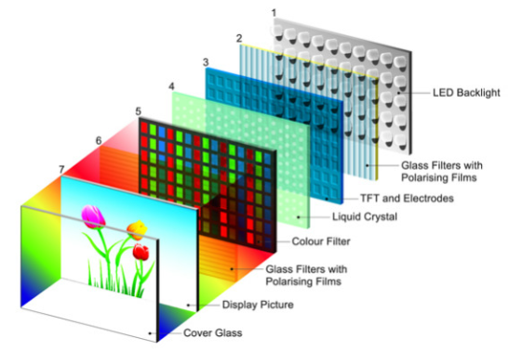
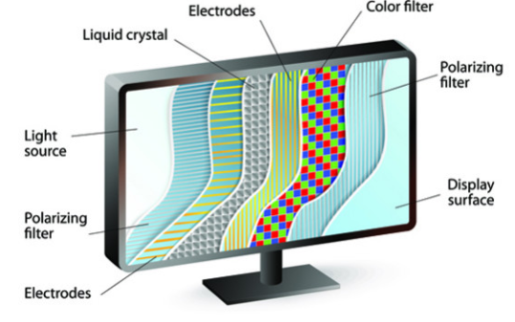
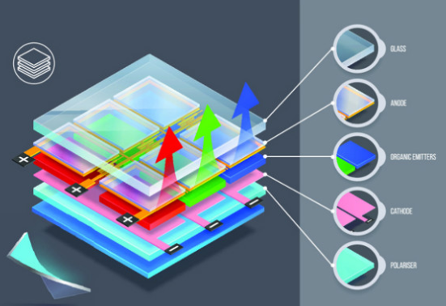
Laptop Display Components LCD, LED, and OLED Displays
There are three types of laptop displays:
Liquid-crystal display (LCD) - Commonly uses Twisted Nematic (TN) or In-Plane switching (IPS).
Light-emitting diode (LED) – Uses less power and has a longer lifespan than LCD.
Organic light-emitting diode (OLED) – Used commonly for mobile devices and digital cameras.
Notes:
7.1 – Characteristics of laptops and other mobile devices
7.1.3 – Laptop Display Components
7.1.3.1 – LCD, LED, and OLED Displays

Slide 35
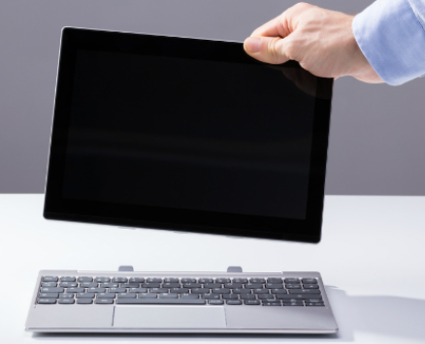


Laptop Display Components Laptop Display Features
Some common laptop display features include:
Detachable screens – Some laptops permit the touchscreen to be used like a tablet when the display is detached.
Touch screens – Laptops with touchscreens have a special glass attached to the front of the screen known as a digitizer.
Cutoff switches – A cutoff switch helps conserve power by turning off the display.
Notes:
7.1 – Characteristics of laptops and other mobile devices
7.1.3 – Laptop Display Components
7.1.3.2 – Laptop Display Features

Slide 36
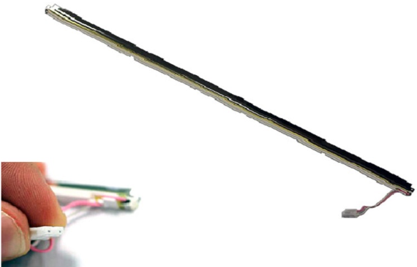
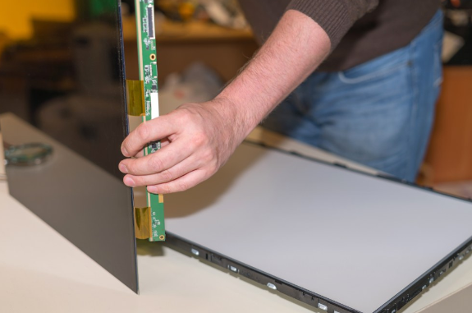

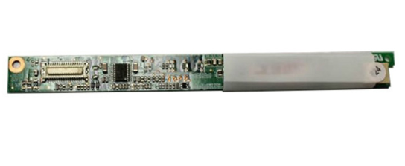
Laptop Display Components Backlights and Inverters
Two common types of backlights are:
cold cathode fluorescent lamp (CCFL)
Light-emitting diode (LED)
Display Components include:
Backlights and Inverters
Fluorescent backlight
Inverter
LED backlights
Notes:
7.1 – Characteristics of laptops and other mobile devices
7.1.3 – Laptop Display Components
7.1.3.3 – Backlights and Inverters
7.1.3.4 – Check Your Understanding – Laptop Display Components

Slide 37
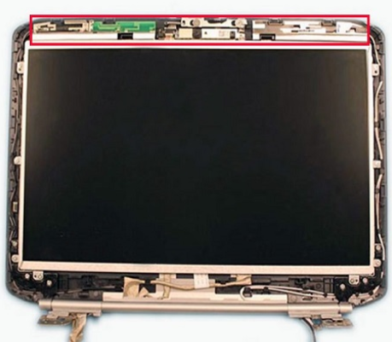
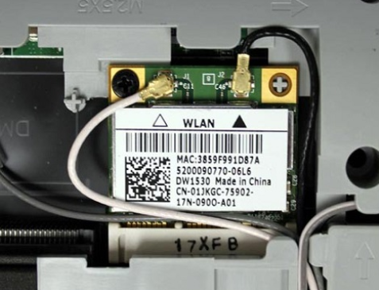
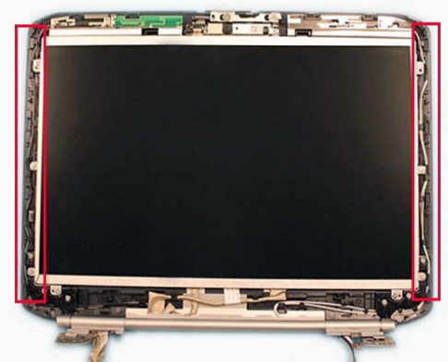
Laptop Display Components Wi-Fi Antenna Connectors
Wi-Fi components include:
Wi-Fi antenna connectors – Wi-Fi antennas in laptops are typically located above the screen.
Wi-Fi antenna leads – The Wi-Fi antenna is connected to a wireless card by an antenna wire and antenna leads.
Wi-Fi antenna wire guides – The wires are fastened to the display unit by wire guides located on the sides of the screen.
Notes:
7.1 – Characteristics of laptops and other mobile devices
7.1.3 – Laptop Display Components
7.1.3.5 – Wi-Fi Antenna Connectors

Slide 38
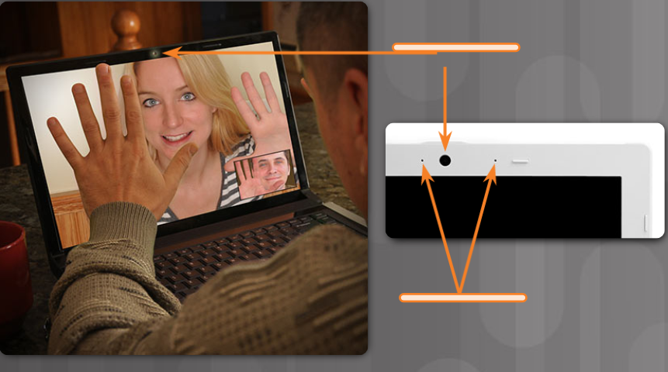
Laptop Display Components Webcam and Microphone
Most laptops today have a webcam and microphone built-in.
The webcam is normally positioned at the top, center of the display.
The internal microphone can often be found next to the webcam.
Some manufacturers may place the microphone next to the keyboard, or on the side of the laptop.
Notes:
7.1 – Characteristics of laptops and other mobile devices
7.1.3 – Laptop Display Components
7.1.3.6 – Webcam and Microphone

Slide 39
7.2 Laptop Configuration
Notes:
7 – Laptops and Other Mobile Devices
7.2 – Laptop Configuration

Slide 40
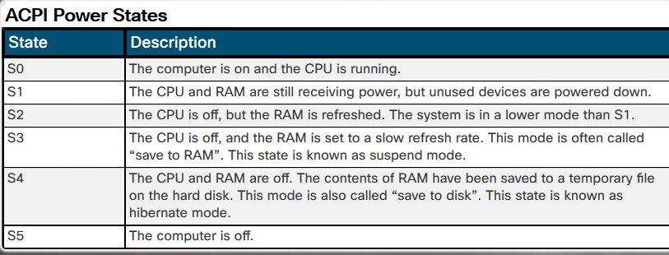
Power Settings Configuration Power Management
Configuring laptop power settings to better manage power usage ensures that the battery is used efficiently.
Power management controls the flow of electricity to the components of a computer.
The Advanced Configuration and Power Interface (ACPI) creates a bridge between the hardware and the operating system and allows technicians to create power management schemes to get the best performance from a laptop.
Notes:
7.2 – Laptop Configuration
7.2.1 – Power Settings Configuration
7.2.1.1 – Power Management

Slide 41
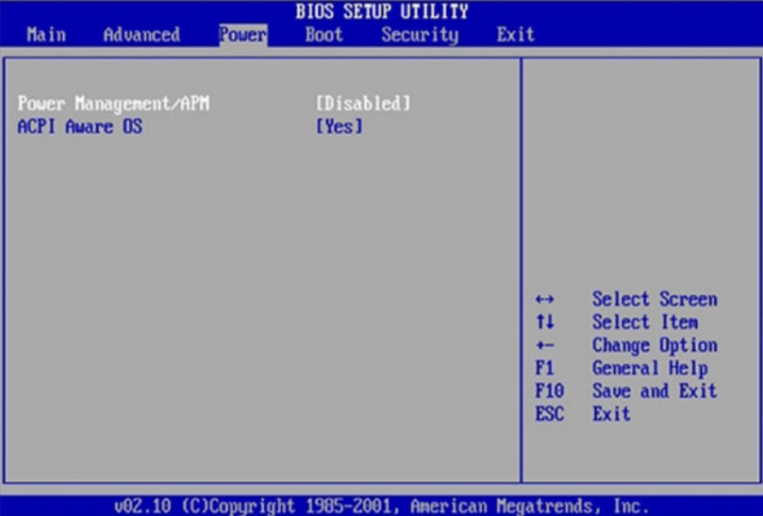
Power Settings Configuration Managing ACPI Settings in the BIOS
Technicians are frequently required to configure power settings by changing the settings in the BIOS or UEFI setup.
Configuring the power settings affects the following:
System states
Battery and AC modes
Thermal management
CPU PCI bus power management
Wake on LAN (WOL)
The ACPI power management mode must be enabled in the BIOS or UEFI to allow the OS to configure the power management states.
Technicians are frequently required to configure power settings by changing the settings in the BIOS or UEFI setup.
Configuring the power settings affects the following:
System states
Battery and AC modes
Thermal management
CPU PCI bus power management
Wake on LAN (WOL)
The ACPI power management mode must be enabled in the BIOS or UEFI to allow the OS to configure the power management states.
Notes:
7.2 – Laptop Configuration
7.2.1 – Power Settings Configuration
7.2.1.2 – Managing ACPI Settings in the BIOS
7.2.1.3 – Check Your Understanding – Match ACPI Standards

Slide 42
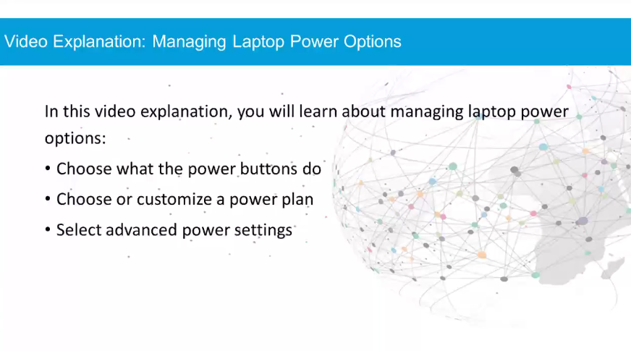
Power Settings Configuration Video Demonstration – Managing Laptop Power Options
Notes:
7.2 – Laptop Configuration
7.2.1 – Power Settings Configuration
7.2.1.4 – Video Demonstration – Managing Laptop Power Options

Slide 43
Wireless Configuration Bluetooth
The Bluetooth technical specification is described by the Institute of Electrical and Electronics Engineers (IEEE) 802.15 standard.
Bluetooth devices are capable of handling voice, music, videos, and data.
The distance of a Bluetooth personal area network (PAN) is limited by the amount of power used by the devices in the PAN
The most common Bluetooth technology has a range of approximately 33 ft (10 m).
Security measures are included in the Bluetooth standard.
The first time that a Bluetooth device connects, the device is authenticated using a PIN.
This is known as pairing. Bluetooth supports both 128-bit encryption and PIN authentication.
Notes:
7.2 – Laptop Configuration
7.2.2 – Wireless Configuration
7.2.2.1 – Bluetooth

Slide 44

Wireless Configuration Bluetooth Laptop Connections
Windows activates connections to Bluetooth devices by default.
If the connection is not active, look for a switch on the front face or on the side of the laptop.
Some laptops may have a special function key on the keyboard to enable the connection.
If a laptop does not include Bluetooth technology, you can purchase a Bluetooth adapter that plugs into a USB port.
Before installing and configuring a device:
Make sure that Bluetooth is enabled in the BIOS.
Turn on the device and make it discoverable.
Use the Bluetooth Wizard to search and discover Bluetooth devices that are in discoverable mode.
Notes:
7.2 – Laptop Configuration
7.2.2 – Wireless Configuration
7.2.2.2– Bluetooth Laptop Connections

Slide 45
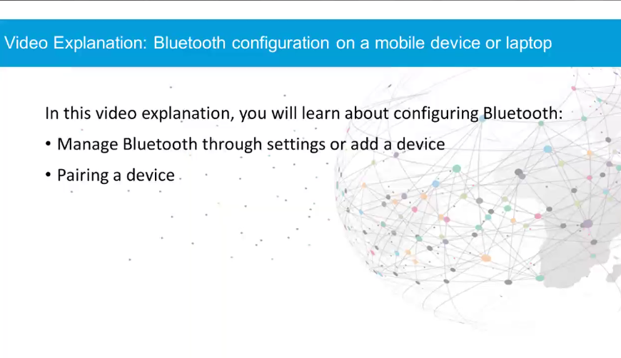
Wireless Configuration Video Demonstration – Bluetooth Configuration
Notes:
7.2 – Laptop Configuration
7.2.2 – Wireless Configuration
7.2.2.3– Video Demonstration – Bluetooth Configuration

Slide 46
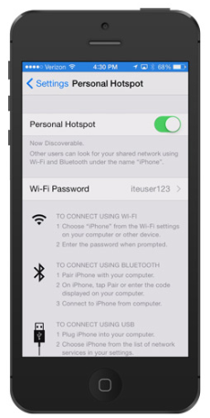
Wireless Configuration Cellular WAN
Laptops with integrated cellular WAN capabilities require no software installation and no additional antenna or accessories.
Some laptops may use a special function key on the keyboard to enable the connection or a physical switch on the front or side of the laptop.
Many cell phones provide the ability to connect other devices to the Internet.
This connection, known as tethering, can be made using Wi-Fi, Bluetooth, or by using a USB cable.
When a cellular phone allows Wi-Fi devices to connect and use the mobile data network, this is called a hotspot.
You can also access a cellular network by using a cellular hotspot device.
Notes:
7.2 – Laptop Configuration
7.2.2 – Wireless Configuration
7.2.2.4– Cellular WAN

Slide 47
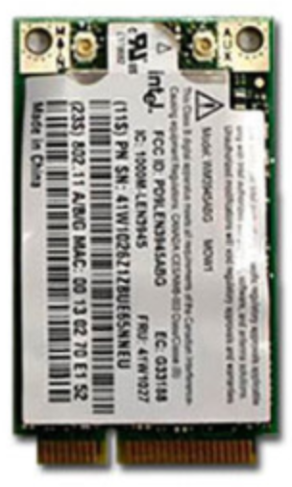
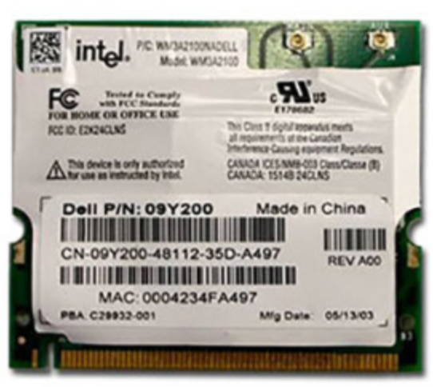
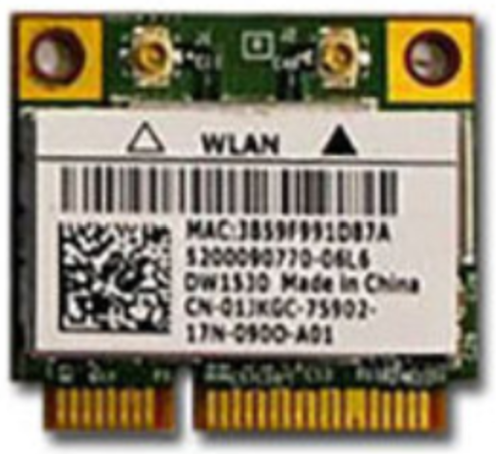
Wireless Configuration Wi-Fi
Laptops usually access the Internet by using wireless adapters.
Wireless adapters can be built-in or attached through a USB or expansion port
Mini-PCI cards are capable of 802.11a, 802.11b, and 802.11g wireless LAN connections.
Mini-PCIe and PCI Express Micro cards support the above standards and 802.11n and 802.11ac.
Mini-PCI
PCI Express Micro
Mini-PCIe
Notes:
7.2 – Laptop Configuration
7.2.2 – Wireless Configuration
7.2.2.5– Wi-Fi

Slide 48
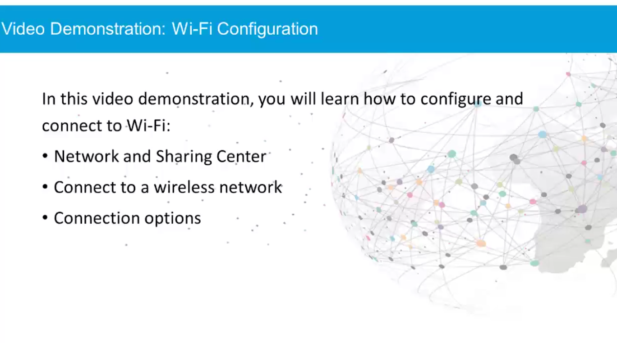
Wireless Configuration Video Demonstration – Wi-Fi Configuration
Notes:
7.2 – Laptop Configuration
7.2.2 – Wireless Configuration
7.2.2.6– Video Demonstration – Wi-Fi Configuration
7.2.2.7 – Check Your Understanding – Wireless Configuration

Slide 49
7.3 Laptop Hardware and Component Installation and Configuration
Notes:
7 – Laptops and Other Mobile Devices
7.3 – Laptop Hardware and Component Installation and Configuration

Slide 50
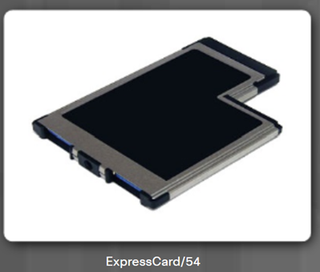
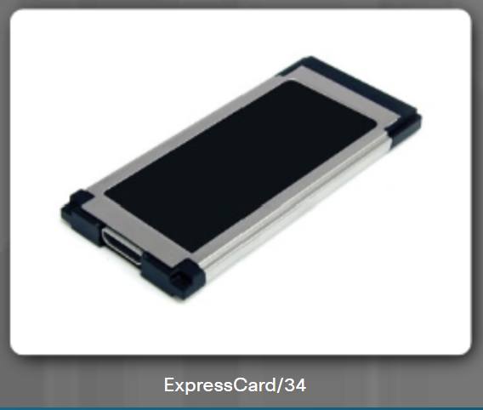
Expansion Slots Express Cards
Express Bus: ExpressCard/54 Size: 75mm x 54mm Thickness: 5mm Interface: PCI Express, USB 2.0, or USB 3.0 Examples: Smart Card reader, Compact Flash reader, 1.8 inch disk drive
Express Bus: ExpressCard/34 Size: 75mm x 34mm Thickness: 5mm Interface: PCI Express, USB 2.0, or USB 3.0 Examples: Firewire, TV Tuner, Wireless NIC
Notes:
7.3 – Laptop Hardware and Component Installation and Configuration
7.3.1 – Expansion Slots
7.3.1.1 – Express Cards

Slide 51
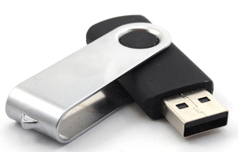
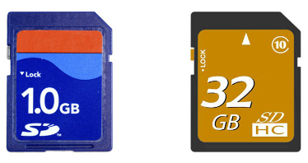
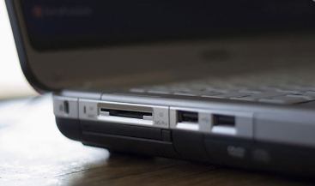
Expansion Slots Flash Memory
External Flash Drive
A removable storage device that connects to an expansion port such as USB, eSATA, or Firewire.
Flash drives provide fast access to data, high reliability, and reduced power usage.
Flash Cards
A flash card is a data storage device that uses flash memory to store information.
Flash cards are small, portable, and require no power to maintain data.
Flash Card Readers
Most modern laptops feature a flash card reader for Secure Digital (SD) and Secure Digital High Capacity (SDHC) flash cards.
Notes:
7.3 – Laptop Hardware and Component Installation and Configuration
7.3.1 – Expansion Slots
7.3.1.2 – Flash Memory

Slide 52
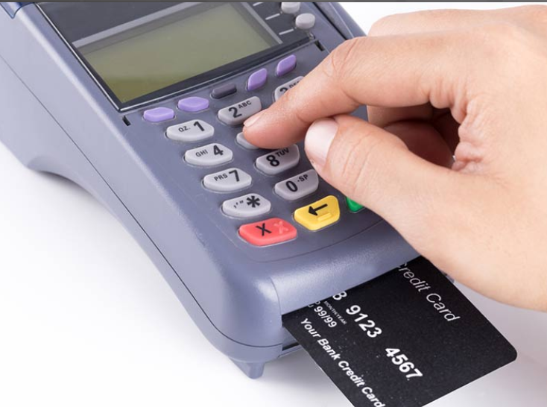
Expansion Slots Smart Card Reader
A smart card is similar to a credit card,but has an embedded microprocessor that can be loaded with data.
It can be used for telephone calling, electronic cash payments, and other applications.
The microprocessor on the smart card can hold much more information than that of a magnetic stripe.
Smart card readers are used to read and write to smart cards.
There are two types of smart card readers:
Contact - This type of reader requires a physical connection to the card, made by inserting the card into the reader
Contactless - This type of reader works on a radio frequency that communicates when the card comes close to the reader.
Notes:
7.3 – Laptop Hardware and Component Installation and Configuration
7.3.1 – Expansion Slots
7.3.1.3 – Smart Card Reader

Slide 53
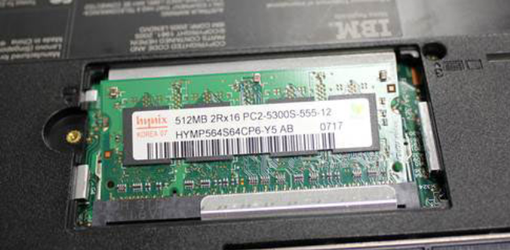
Expansion Slots SODIMM Memory
Most desktop computers use memory that fits into a DIMM slot.
Most laptops use a smaller profile memory module that is called SODIMM. Note: SODIMMs can be further classified by DDR version. Different laptop models require different types of SODIMMs.
On most laptops, RAM is inserted into slots behind a cover on the underside of the case.
On some laptops, the keyboard must be removed to access the RAM slots.
You can view the currently installed amount of RAM in the POST screen, BIOS, or System Properties window.
Notes:
7.3 – Laptop Hardware and Component Installation and Configuration
7.3.1 – Expansion Slots
7.3.1.4 – SODIMM Memory

Slide 54
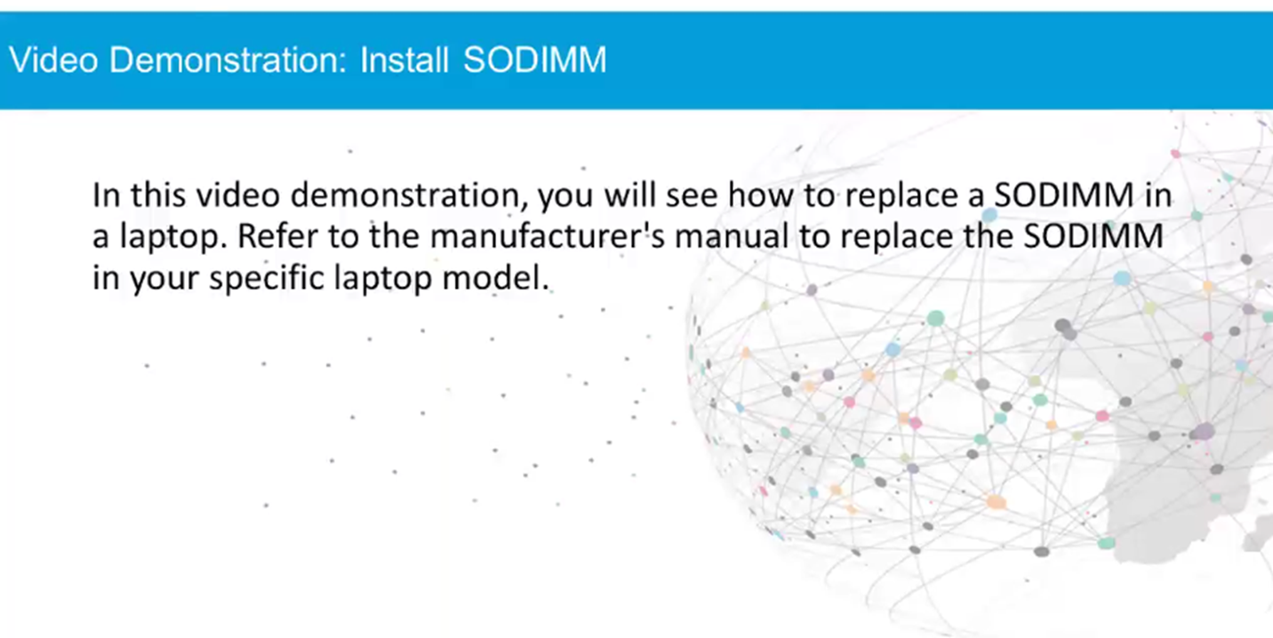
Expansion Slots Video Demonstration – Install SODIMM
Notes:
7.3 – Laptop Hardware and Component Installation and Configuration
7.3.1 – Expansion Slots
7.3.1.5 – Video Demonstration – Install SODIMM
7.3.1.6 – Check Your understanding – Expansion Modules

Slide 55
Replacing Laptop Components Overview of Hardware Replacement
Some parts of a laptop, typically called customer-replaceable units (CRUs), can be replaced by the customer.
CRUs include components such as the laptop battery and RAM.
Parts that should not be replaced by the customer are called field-replaceable units (FRUs).
FRUs include components such as the motherboard, LCD display, and keyboard.
The following are common repairs performed at local repair centers:
Hardware and software diagnostics
Data transfer and recovery
Keyboard and fan replacement
Internal laptop cleaning
Screen repair
LCD inverter and backlight repair
Notes:
7.3 – Laptop Hardware and Component Installation and Configuration
7.3.2 – Replacing Laptop Components
7.3.2.1 – Overview of Hardware Replacement

Slide 56
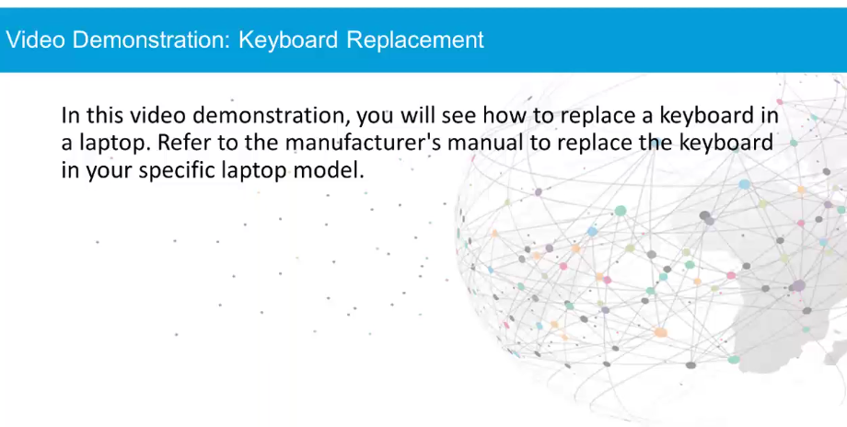
Replacing Laptop Components Keyboard Replacement
Notes:
7.3 – Laptop Hardware and Component Installation and Configuration
7.3.2 – Replacing Laptop Components
7.3.2.2 – Keyboard Replacement

Slide 57
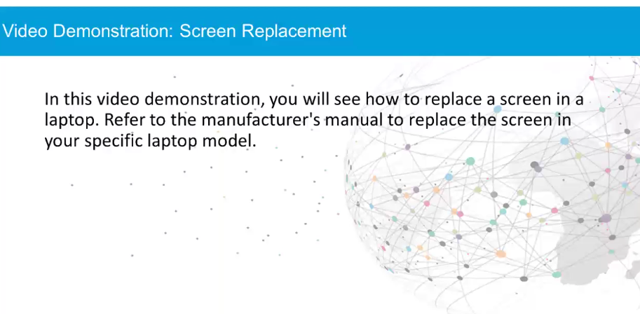
Replacing Laptop Components Screen Replacement
Notes:
7.3 – Laptop Hardware and Component Installation and Configuration
7.3.2 – Replacing Laptop Components
7.3.2.3 – Screen Replacement

Slide 58
Replacing Laptop Components Lab- Research Laptop Screens
In this lab, you will use the internet or a local store to gather information and then record the specifications for a laptop display onto this worksheet.
Notes:
7.3 – Laptop Hardware and Component Installation and Configuration
7.3.2 – Replacing Laptop Components
7.3.2.4 – Lab – Research Laptops Screens

Slide 59
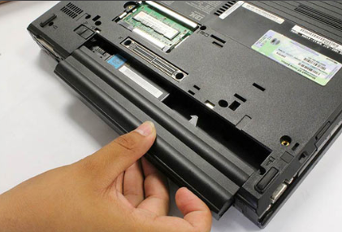
Replacing Laptop Components Power
These are some signs that the battery may need to be replaced:
The battery does not hold a charge.
The battery overheats.
The battery is leaking.
If you experience problems that you suspect are battery related, exchange the battery with a known, good battery that is compatible with the laptop.
A replacement battery must meet or exceed the specifications of the laptop manufacturer.
New batteries must use the same form factor as the original battery.
Voltages, power ratings, and AC adapters must also meet manufacturer specifications.
Notes:
7.3 – Laptop Hardware and Component Installation and Configuration
7.3.2 – Replacing Laptop Components
7.3.2.5 – Power

Slide 60
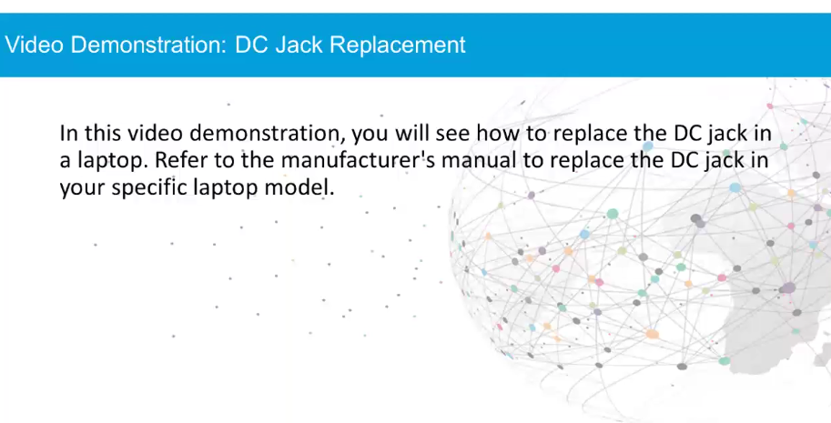
Replacing Laptop Components Video Demonstration – DC Jack Replacement
Notes:
7.3 – Laptop Hardware and Component Installation and Configuration
7.3.2 – Replacing Laptop Components
7.3.2.6 – Video Demonstration – DC Jack Replacement

Slide 61
Replacing Laptop Components Lab- Research Laptop Batteries
In this lab, you will use the internet or a local store to gather information and then record the specifications for a laptop battery.
Notes:
7.3 – Laptop Hardware and Component Installation and Configuration
7.3.2 – Replacing Laptop Components
7.3.2.7 – Lab – Research Laptops Batteries

Slide 62
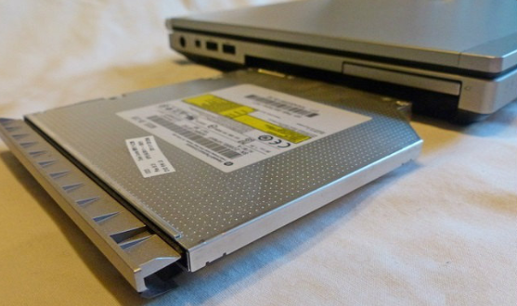
Replacing Laptop Components Internal Storage and Optical Drive
The form factor of an internal storage device is smaller for a laptop than for a desktop computer.
Laptop drives are 1.8 in. (4.57 cm.) or 2.5 in. (6.35 cm.) in width.
Most storage devices are CRUs unless a warranty requires technical assistance.
On most laptops, the internal hard drive and the internal optical drive are inserted into bays that are protected by a removable cover on the case.
On some laptops, the keyboard must be removed to access these drives.
To view the currently installed storage devices, check the POST screen or BIOS.
Notes:
7.3 – Laptop Hardware and Component Installation and Configuration
7.3.2 – Replacing Laptop Components
7.3.2.8 – Internal Storage and Optical Drive

Slide 63
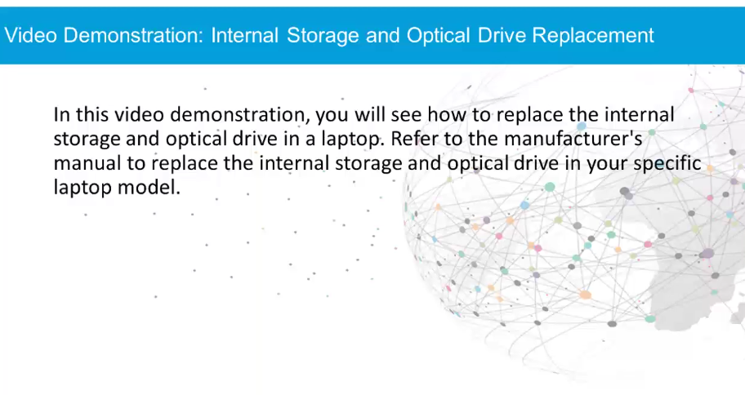
Replacing Laptop Components Video Demonstration – Internal Storage and Optical Drive Replacement
Notes:
7.3 – Laptop Hardware and Component Installation and Configuration
7.3.2 – Replacing Laptop Components
7.3.2.9 – Video Demonstration – Internal Storage and Optical Drive Replacement

Slide 64
Replacing Laptop Components Lab- Research Laptop Drives
In this lab, you will use the internet or a local store to gather information about storage and optical drives for a laptop.
Notes:
7.3 – Laptop Hardware and Component Installation and Configuration
7.3.2 – Replacing Laptop Components
7.3.2.10 – Lab – Research Laptops Drives

Slide 65
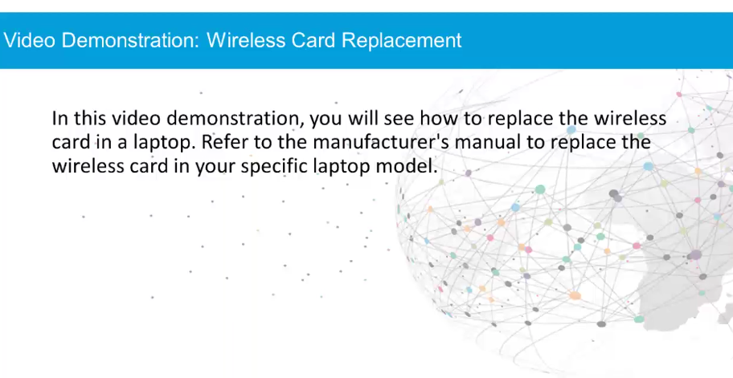
Replacing Laptop Components Video Demonstration – Wireless Card Replacement
Notes:
7.3 – Laptop Hardware and Component Installation and Configuration
7.3.2 – Replacing Laptop Components
7.3.2.11 – Video Demonstration – Wireless Card Replacement

Slide 66
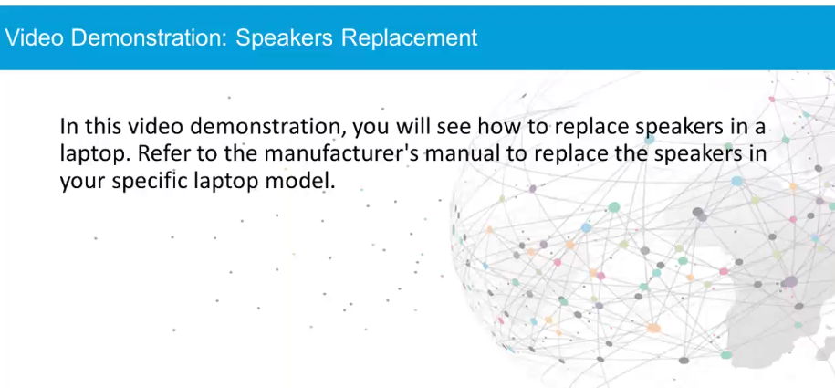
Replacing Laptop Components Video Demonstration – Speakers Replacement
Notes:
7.3 – Laptop Hardware and Component Installation and Configuration
7.3.2 – Replacing Laptop Components
7.3.2.12 – Video Demonstration – Speakers Replacement

Slide 67
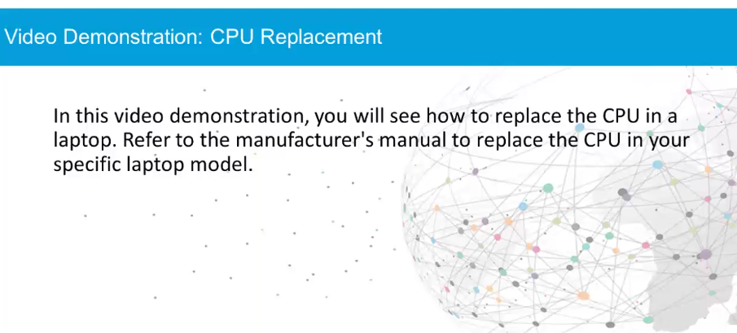
Replacing Laptop Components Video Demonstration – CPU Replacement
Notes:
7.3 – Laptop Hardware and Component Installation and Configuration
7.3.2 – Replacing Laptop Components
7.3.2.13 – Video Demonstration – CPU Replacement

Slide 68

Replacing Laptop Components Video Demonstration – Motherboard Replacement
Notes:
7.3 – Laptop Hardware and Component Installation and Configuration
7.3.2 – Replacing Laptop Components
7.3.2.14 – Video Demonstration – Motherboard Replacement

Slide 69

Replacing Laptop Components Video Demonstration – Plastic Frames
Notes:
7.3 – Laptop Hardware and Component Installation and Configuration
7.3.2 – Replacing Laptop Components
7.3.2.15 – Video Demonstration – Plastic Frames
7.3.2.16 – Check Your Understanding – Replacing Laptop Components

Slide 70
7.4 Other Mobile Device Hardware
Notes:
7 – Laptops and Other Mobile Devices
7.4 – Other Mobile Device Hardware

Slide 71


Other Mobile Device Hardware Cell Phone Parts
The cell phone contains one or more of these field replaceable parts:
Memory, a SIM card, and a battery.
A SIM card contains information used to authenticate a device to mobile telephone and data providers.
The card can also hold user data such as personal contacts and text messages.
A Secure Digital (SD) card is used to add memory to many mobile devices.
When a mobile device malfunctions, it is usually sent to the manufacturer for repair or replacement.
Notes:
7.4 – Other Mobile Device Hardware
7.4.1 – Other Mobile Device Hardware
7.4.1.1 – Cell Phone Parts

Slide 72

Other Mobile Device Hardware Wired Connectivity
A mini-USB cable is used to connect a mobile device to an electrical outlet charger or to another device in order to charge and/or transfer data.
A USB-C cable and port can be plugged in either direction and are used on mobile devices to connect to an electrical outlet charger or to another device in order to charge and/or transfer data.
A micro-USB cable is used to connect a mobile device to an electrical outlet charger or to another device in order to charge and/or transfer data.
A Lightning cable and port is used to connect Apple devices to host computers and other peripherals such as USB battery chargers, monitors, and cameras.
Notes:
7.4 – Other Mobile Device Hardware
7.4.1 – Other Mobile Device Hardware
7.4.1.2 – Wired Connectivity

Slide 73
Other Mobile Device Hardware Wireless Connections and Shared Internet Connections
Besides Wi-Fi, mobile devices also use the following wireless connections:
Near field communication (NFC) – NFC enables mobile devices to establish radio communications with other devices by placing the devices close together or by touching them together.
Infrared (IR) – If a mobile device is IR enabled, it can be used to control other IR controlled devices remotely, such as a TV, set top box, or audio equipment.
Bluetooth – This allows data exchange over a short distance between two Bluetooth-enabled devices or connect to other Bluetooth-enabled peripheral devices, such as speakers or headphone
A smartphone’s internet connection can be shared with other devices.
Tether – This uses your cellular phone as a modem for another device, such as a tablet or laptop.
Mobile hotspot – A hotspot is where devices connect using Wi-Fi to share a cellular data connection.
Notes:
7.4 – Other Mobile Device Hardware
7.4.1 – Other Mobile Device Hardware
7.4.1.3 – Wireless Connections and Shared Internet Connections
7.4.1.4 – Check Your Understanding – Identify Connection Types

Slide 74



Specialty Mobile Devices Wearable Devices
Wearable devices are clothing or accessories that have miniature computing devices.
Smartwatches, fitness monitors, and smart headsets are some examples.
Fitness monitors measure and collect activity data and can connect with other Internet-connected devices to upload the data for later review.
VR headsets provide the wearer with a complete immersion experience shutting out the physical world.
Augmented reality (AR) headsets overlay digital elements to a live view of the physical world often using the camera of a smartphone.
Notes:
7.4 – Other Mobile Device Hardware
7.4.2 – Specialty Mobile Devices
7.4.2.1 – Wearable Devices

Slide 75


Specialty Mobile Devices Specialty Devices
There are many other types of smart devices that benefit from network connectivity and advanced functions.
Global Positioning System (GPS) is a satellite-based navigation system.
GPS satellites are located in space and transmit signals back to Earth.
An electronic reader, or e-reader, is a device optimized for reading electronic books, e-books, newspapers, and other documents.
These have Wi-Fi or cellular connectivity for downloading content.
Notes:
7.4 – Other Mobile Device Hardware
7.4.2 – Specialty Mobile Devices
7.4.2.2 – Specialty Devices

Slide 76
7.5 Network Connectivity and Email
Notes:
7 – Laptops and Other Mobile Devices
7.5 – Network Connectivity and Email

Slide 77
Wireless and Cellular Data Networks Wireless Data Networks
The ability of a laptop, tablet, or cell phone to wirelessly connect to the internet has provided people with the freedom to work, learn, communicate, and play wherever they want.
Mobile devices typically have two wireless internet connectivity options:
Wi-Fi - Wireless network connection is provided using local Wi-Fi settings.
Cellular - Wireless network connection is provided for a fee using cellular data. Cellular networks require cellular towers and satellites to create a mesh of global coverage.
Wi-Fi is usually preferred over a cellular connection because it is usually free and Wi-Fi radios use less battery power than cellular radios.
Many businesses, organizations, and locations now also offer free Wi-Fi connections to attract customers.
It is important to take precautions and secure home Wi-Fi networks. Use the highest Wi-Fi security framework possible and use encryption such as a VPN connection.
Notes:
7.5 – Network Connectivity and Email
7.5.1 – Wireless and Cellular Data Networks
7.5.1.1 – Wireless Data Networks

Slide 78
Wireless and Cellular Data Networks Lab- Mobile Wi-Fi
In this lab, you will turn the Wi-Fi radio on and off, forget a found Wi-Fi network, and find and connect to a WiFi network.
Notes:
7.5 – Network Connectivity and Email
7.5.1 – Wireless and Cellular Data Networks
7.5.1.2 – Lab – Mobile Wi-Fi

Slide 79
Wireless and Cellular Data Networks Cellular Communication Standards
Cellular standards have not been adopted uniformly around the world so some cell phones may only work in one country and not operate in other countries.
Cellular technology has evolved approximately every 10 years.
1G – Introduced in the 1980s, first generation (1G) standards used analog standards.
2G - Introduced in the 1990s, the second generation (2G) standards switched from analog to digital standards. 2G provided speeds up to 1 Mb/s and supported higher call quality. 2G also introduced Short Message Service (SMS) and Multimedia Message Service (MMS).
3G – Introduced in the late 1990s, third-generation (3G) standards enabled speeds up to 2 Mb/s to support mobile internet access, web browsing, video calls, video streaming, and picture sharing.
4G – Introduced in the late 2000s, 4G standards enables speeds of 100 Mb/s and up to 1Gb/s to support gaming services, high-quality video conferencing, and high-definition television. Long Term Evolution (LTE) adds improvements to 4G.
5G – Introduced in 2019, 5G is the latest standard. It is more efficient than previous standards and may support speeds up to 20 Gb/s.
Notes:
7.5 – Network Connectivity and Email
7.5.1 – Wireless and Cellular Data Networks
7.5.1.3– Cellular Communication Standards

Slide 80

Wireless and Cellular Data Networks Airplane Mode
Most mobile devices have a setting called Airplane Mode.
This setting turns off all cellular, as well as Wi-Fi and Bluetooth radios.
Most mobile device functions are still usable, but communication is not possible.
Airplane Mode is useful when traveling on an airplane or when traveling where accessing data is prohibited or expensive.
You can also enable or disable cellular access specifically on a device instead of using the Airplane Mode setting.
Notes:
7.5 – Network Connectivity and Email
7.5.1 – Wireless and Cellular Data Networks
7.5.1.4– Airplane Mode

Slide 81

Wireless and Cellular Data Networks Hotspot
A hotspot is when a cellular device is used to provide an internet connection to other devices.
A cell phone can be used as a bridge to the internet, through the cellular carrier’s network.
The Wi-Fi devices could select the cellular device at its Wi-Fi connection.
To enable an iOS device to become a personal hotspot, touch Personal Hotspot
The iOS Personal Hotspot feature can also connect Bluetooth or USB connected devices to the internet.
A hotspot is sometimes referred to as tethering.
Notes:
7.5 – Network Connectivity and Email
7.5.1 – Wireless and Cellular Data Networks
7.5.1.5– Hotspot
7.5.1.6 – Check Your Understanding – Wireless Technology

Slide 82

Bluetooth Bluetooth for Mobile Devices
Common Bluetooth devices for mobile devices include:
Wireless speakers
Wireless headphones
Wireless keyboard or mouse
Wireless gaming consoles
Notes:
7.5 – Network Connectivity and Email
7.5.2 – Bluetooth
7.5.2.1– Bluetooth for Mobile Devices

Slide 83

Wireless and Cellular Data Networks Bluetooth Pairing
Bluetooth pairing is when two Bluetooth devices establish a connection to share resources.
When a Bluetooth device is in discoverable mode, it transmits Bluetooth and device information such as device name, services that the device can use, Bluetooth class and device name.
During the pairing process, a PIN may be requested to authenticate the pairing process
The PIN is often a number, but can also be a numeric code or passkey.
The PIN is stored using pairing services, so it does not have to be entered the next time the device tries to connect.
Notes:
7.5 – Network Connectivity and Email
7.5.2 – Bluetooth
7.5.2.2– Bluetooth Pairing

Slide 84

Configuring Email Introduction to Email
The email structure relies on email servers and email clients
Email servers require email software such as Microsoft Server Exchange.
Exchange is also a contact manager and calendaring software.
It uses a proprietary messaging architecture called Messaging Application Programming Interface (MAPI).
MAPI is used by the Microsoft Office Outlook client to connect to Exchange servers, to provide email, calendar, and contact management.
Notes:
7.5 – Network Connectivity and Email
7.5.3 – Configuring Email
7.5.3.1– Introduction to Email

Slide 85





Configuring Email Introduction to Email (Cont.)
Email clients and servers use various protocols and standards to exchange emails.
Notes:
7.5 – Network Connectivity and Email
7.5.3 – Configuring Email
7.5.3.1– Introduction to Email (Cont.)

Slide 86

Configuring Email Introduction to Email (Cont.)
Email clients have to be installed on a mobile device.
Many clients are configurable using a wizard, however, you still need to know key information to set up an email account.
Notes:
7.5 – Network Connectivity and Email
7.5.3 – Configuring Email
7.5.3.1– Introduction to Email (Cont.)
7.5.3.2 – Check Your Understanding – Matching Email Protocols

Slide 87
Configuring Email Android Email Configuration
Android devices are capable of using advanced communication applications and data services.
Many of these applications and features require the use of web services provided by Google.
When you configure an Android mobile device for the first time, you are prompted to sign in to your Google account with your Gmail email address and password.
By signing in to your Gmail account, the Google Play store, data and settings backup, and other Google services become accessible.
The device synchronizes contacts, email messages, apps, downloaded content, and other information from Google services.
Notes:
7.5 – Network Connectivity and Email
7.5.3 – Configuring Email
7.5.3.3– Android Email Configuration

Slide 88
Configuring Email iOS Email Configuration
iOS devices ship with a stock Mail app which can handle multiple email accounts simultaneously.
The Mail app also supports a number of different email account types including iCloud, Yahoo, Gmail, Outlook and Microsoft Exchange.
An Apple ID is required to set up an iOS device.
An Apple ID is used to access the Apple App Store, the iTunes Store, and iCloud.
All of the iOS devices, apps, and content are linked to your Apple ID.
The iCloud email is free and comes with remote storage for backups, mail, and documents.
When an iOS device is turned on for the first time, the Setup Assistant guides you through the process of connecting the device and signing in with or creating an Apple ID.
You can restore settings, content, and apps from a different iOS device from an iCloud backup during the setup process.
Notes:
7.5 – Network Connectivity and Email
7.5.3 – Configuring Email
7.5.3.4– iOS Email Configuration

Slide 89

Configuring Email Internet Email
Email service is provided using either:
Local email – The email server is managed by a local IT department such as a school network, business network, or organizational network.
Internet email – The email service is hosted on the internet and controlled by a service provider such as Gmail.
Users can access their online mailboxes using:
Default mobile email app included in the OS such as iOS Mail.
Browser-based email client, such as Mail, Outlook, Windows Live Mail, and Thunderbird.
Mobile email client apps, including Gmail and Yahoo.
Email client apps provide a better user experience when compared to the web interface.
Notes:
7.5 – Network Connectivity and Email
7.5.3 – Configuring Email
7.5.3.5– Internet Email

Slide 90
Mobile Device Synchronization Types of Data to Synchronize
Many people use a combination of desktop, laptop, tablet, and smartphone devices to access and store information.
Data synchronization is the exchange of data between two or more devices while maintaining consistent data on those devices.
Synchronization methods include synchronization to the cloud, a desktop, and an automobile.
There are many different types of data to synchronize:
Contacts
Applications
Email
Pictures, Music, Videos, Documents
Calendar
Bookmarks
Location data
Social media data
E-books
Passwords
Notes:
7.5 – Network Connectivity and Email
7.5.4 – Mobile Device Synchronization
7.5.4.1 – Types of Data to Synchronize

Slide 91
Mobile Device Synchronization Enabling Synchronization
Sync typically means data synchronization.
Android devices can synchronize your contacts and other data including that from Facebook, Google, and Twitter.
All devices using the same Google account will have access to the same data.
Android Sync also allows the user to choose the types of data to synchronize.
Android devices also support automatic synchronization with a feature called Auto Sync.
iOS devices support two types of synchronizing:
Backup - Copies your personal data from your phone to your computer and includes application settings, text messages, voicemails, and other data types.
Sync - Copies new apps, music, video, or books from iTunes to your phone and from your phone to iTunes, resulting in full synchronization on both devices.
A few more useful options are available when performing Sync or Backup on iOS:
Backup storage location
Backup straight from an iOS device
Sync over Wi-Fi
Notes:
7.5 – Network Connectivity and Email
7.5.4 – Mobile Device Synchronization
7.5.4.2 – Enabling Synchronization

Slide 92

Mobile Device Synchronization Synchronization Connection Types
To synchronize data between devices, the devices use USB or Wi-Fi connections.
Most Android devices do not have a desktop program for performing data synchronization. Most users sync with Google’s different web services.
iOS devices can use USB or Wi-Fi Sync to synchronize with iTunes.
To use Wi-Fi Sync, the iOS device must first synchronize with iTunes using a USB cable.
Microsoft also offers cloud storage for synchronizing data between devices through the use of OneDrive.
Notes:
7.5 – Network Connectivity and Email
7.5.4 – Mobile Device Synchronization
7.5.4.3 – Synchronization Connection Types

Slide 93
7.6 Preventive Maintenance for Laptops and other Mobile Devices
Notes:
7 – Laptops and Other Mobile Devices
7.6 – Preventive Maintenance for Laptops and other Mobile Devices

Slide 94

Scheduled Maintenance for Laptops and other Mobile Devices The Reason for Maintenance
Because laptops and mobile devices are portable, they are used in different types of environments.
As a result, they are more likely than desktop computers to be exposed to harmful materials and situations, including dirt and contamination, spills, drops, excessive heat or cold, and excessive moisture.
In a laptop, many components are placed in a very small area directly beneath the keyboard.
Spilling liquid onto the keyboard can result in severe internal damage.
Proper care and maintenance can help laptop components run more efficiently and extend the life of the equipment.
Notes:
7.6 – Preventive Maintenance for Laptops and other Mobile Devices
7.6.1 – Scheduled Maintenance for Laptops and other Mobile Devices
7.6.1.1 – What Do You Already Know? – Preventive Maintenance
7.6.1.2 – The Reason for Maintenance

Slide 95
Scheduled Maintenance for Laptops and other Mobile Devices Laptop Preventive Maintenance Program
The preventive maintenance schedule for a laptop may include practices that are unique to a particular organization but should also include the standard procedures of cleaning, hard drive maintenance, and software updates.
Routine maintenance includes the monthly cleaning of these laptop components:
Exterior case
Cooling vents and I/O ports
Display
Keyboard
Touchpad
When cleaning a laptop, never use harsh cleaners or solutions that contain ammonia.
Use nonabrasive materials including compressed air, mild cleaning solutions, cotton swabs, and a soft, lint-free cloth .
Notes:
7.6 – Preventive Maintenance for Laptops and other Mobile Devices
7.6.1 – Scheduled Maintenance for Laptops and other Mobile Devices
7.6.1.3 – Laptop Preventive Maintenance Program

Slide 96

Scheduled Maintenance for Laptops and other Mobile Devices Mobile Device Preventive Maintenance Program
Mobile devices can be damaged by drops, excess moisture, heat, or cold
The touchscreen should be protected using a screen protector.
Preventative maintenance for mobile devices requires only three basic tasks:
Clean using a soft, lint-free cloth and cleaning solution designed for a touchscreen.
Back up the data to another source or to a cloud drive.
Update the operating system and applications when available.
Notes:
7.6 – Preventive Maintenance for Laptops and other Mobile Devices
7.6.1 – Scheduled Maintenance for Laptops and other Mobile Devices
7.6.1.4 – Mobile Device Preventive Maintenance Program

Slide 97
7.7 Basic Troubleshooting Process for Laptops and other Mobile Devices
Notes:
7 – Laptops and Other Mobile Devices
7.7 – Basic Troubleshooting Process for Laptops and other Mobile Devices

Slide 98

Six Steps of Troubleshooting Laptops and Other Mobile Devices Troubleshooting Steps
Notes:
7.7 – Basic Troubleshooting Process for Laptops and other Mobile Devices
7.7.1 – Six Steps of Troubleshooting Laptops and Other Mobile Devices
7.7.1.1 – Troubleshooting Steps

Slide 99

Six Steps of Troubleshooting Laptops and Other Mobile Devices Identify the Problem
Notes:
7.7 – Basic Troubleshooting Process for Laptops and other Mobile Devices
7.7.1 – Six Steps of Troubleshooting Laptops and Other Mobile Devices
7.7.1.2 – Identify the Problem

Slide 100

Six Steps of Troubleshooting Laptops and Other Mobile Devices Establish a Theory of Probable Cause
Notes:
7.7 – Basic Troubleshooting Process for Laptops and other Mobile Devices
7.7.1 – Six Steps of Troubleshooting Laptops and Other Mobile Devices
7.7.1.3 – Establish a Theory of Probable Cause

Slide 101

Six Steps of Troubleshooting Laptops and Other Mobile Devices Test the Theory to Determine Cause
Notes:
7.7 – Basic Troubleshooting Process for Laptops and other Mobile Devices
7.7.1 – Six Steps of Troubleshooting Laptops and Other Mobile Devices
7.7.1.4 – Test the Theory to Determine Cause

Slide 102

Six Steps of Troubleshooting Laptops and Other Mobile Devices Establish a Plan of Action to Resolve the Problem and Implement the Solution
Notes:
7.7 – Basic Troubleshooting Process for Laptops and other Mobile Devices
7.7.1 – Six Steps of Troubleshooting Laptops and Other Mobile Devices
7.7.1.5 – Establish a Plan of Action to Resolve the Problem and Implement the Solution

Slide 103

Six Steps of Troubleshooting Laptops and Other Mobile Devices Verify Full System Functionality and if Applicable Implement Preventive Measures
Notes:
7.7 – Basic Troubleshooting Process for Laptops and other Mobile Devices
7.7.1 – Six Steps of Troubleshooting Laptops and Other Mobile Devices
7.7.1.6 – Verify Full System Functionality and if Applicable Implement Preventive Measures

Slide 104

Six Steps of Troubleshooting Laptops and Other Mobile Devices Document Findings, Actions, and Outcomes
Notes:
7.7 – Basic Troubleshooting Process for Laptops and other Mobile Devices
7.7.1 – Six Steps of Troubleshooting Laptops and Other Mobile Devices
7.7.1.7 – Document Findings, Actions, and Outcomes

Slide 105

Common Problems and Solutions for Laptops and other Mobile Devices Identify Common Problems and Solutions
Laptops and other mobile device problems can be attributed to hardware, software, networks, or some combination of the three. You will resolve some types of problems more often than others.
Notes:
7.7 – Basic Troubleshooting Process for Laptops and other Mobile Devices
7.7.2 – Common Problems and Solutions for Laptops and other Mobile Devices
7.7.2.1 – Identify Common Problems and Solutions

Slide 106

Basic Troubleshooting for Laptops and Other Mobile Devices Common Problems and Solutions for Laptops and Other Mobile Devices
Notes:
7.7 – Basic Troubleshooting Process for Laptops and other Mobile Devices
7.7.2 – Common Problems and Solutions for Laptops and Other Mobile Devices
7.7.2.2 – Common Problems and Solutions for Laptops

Slide 107

Basic Troubleshooting for Laptops and Other Mobile Devices Common Problems and Solutions for Other Mobile Devices
Notes:
7.7 – Basic Troubleshooting Process for Laptops and other Mobile Devices
7.7.2 – Common Problems and Solutions for Laptops and Other Mobile Devices
7.7.2.3 – Common Problems and Solutions for Other Mobile Devices

Slide 108
Common Problems and Solutions for Laptops and other Mobile Devices Lab – Research Laptop Problems
Laptops often use proprietary parts. To find information about the replacement parts, you may have to research the website of the laptop manufacturer.
Notes:
7.7 – Basic Troubleshooting Process for Laptops and other Mobile Devices
7.7.2 – Common Problems and Solutions for Laptops and other Mobile Devices
7.7.2.4 – Lab – Research Laptop Problems

Slide 109
Common Problems and Solutions for Laptops and other Mobile Devices Lab – Gather Information from the Customer
In this lab, you will act as a call center technician and create closed-ended and open-ended questions to ask a customer about a laptop problem.
Notes:
7.7 – Basic Troubleshooting Process for Laptops and other Mobile Devices
7.7.2 – Common Problems and Solutions for Laptops and other Mobile Devices
7.7.2.5 – Lab – Gather Information from the Customer

Slide 110
Common Problems and Solutions for Laptops and other Mobile Devices Lab – Investigate Support Websites
In this lab, you will investigate the services provided by a local laptop repair company or a laptop manufacturer’s support website. Use the internet or a local phone directory to locate a local laptop repair company or laptop manufacturer’s support website.
Notes:
7.7 – Basic Troubleshooting Process for Laptops and other Mobile Devices
7.7.2 – Common Problems and Solutions for Laptops and other Mobile Devices
7.7.2.6 – Lab – Investigate Support Websites

Slide 111
7.8 Chapter Summary
Notes:
7 – Laptops and Other Mobile Devices
7.8 – Chapter Summary

Slide 112
Conclusion Chapter 7: Laptops and Other Mobile Devices
Explain the features and functions of laptops and other mobile devices.
Explain how to configure laptop power settings and wireless settings.
Explain how to remove and install laptop components.
Describe the purpose and characteristics of other mobile devices.
Explain how to configure network connectivity and email on mobile devices.
Explain common preventive maintenance techniques for Laptops and other Mobile Devices.
Explain how to troubleshoot Laptops and other Mobile Devices.
Notes:
7.8 – Chapter Summary
7.8.1 – Conclusion
7.8.1.1 – Chapter 7: Laptops and Other Mobile Devices

Slide 113
Section 7.1 New Terms and Commands
Smartwatch Laptop Tablet Smartphone E-reader Mobility Fitness tracker Virtual reality Augmented reality | Docking station Port replicator LCD LED OLED Inverter Digitizer ACPI
Notes:
New Terms and Commands

Slide 114
Section 7.2 New Terms and Commands
Bluetooth Cellular WAN Tethering Hotspot | Mini-PCI Mini-PCIe PCI Express Micro
Notes:
New Terms and Commands

Slide 115
Section 7.3 New Terms and Commands
Express Card/54 Express Card/34 External Flash Drive Flash card Flash card reader AC adapter | Contact smart card reader Contactless smart card reader SODIMM memory CRUs FRUs DC jack
Notes:
New Terms and Commands

Slide 116
Section 7.4 New Terms and Commands
SIM card SD card Dual SIM Mini-USB Micro-USB USB-C Lightning cable NFC IR | Bluetooth Fitness monitor Smartwatch VR/AR headset GPS receiver E-reader
Notes:
New Terms and Commands

Slide 117
Section 7.5 New Terms and Commands
1G 2G 3G 4G LTE 5G Exchange Local email Internet email Synchronization (backup/sync) | Airplane mode Email server Email client MAPI POP3 IMAP SMTP MIME SSL
Notes:
New Terms and Commands

Slide 118
Section 7.6 New Terms and Commands
None
Notes:
New Terms and Commands

Slide 119
Section 7.7 New Terms and Commands
None
Notes:
New Terms and Commands

